Slide 1
IOT BASED PET MONITORING SYSTEM
By: Advaith R
Yuvanshankar S
Dharanidharan SI

Slide 2
Table of Contents
TOPIC
Abstract
Background
Literature Survey
Problem Description
Research Gap and Proposed Solution
Tools
Results and Discussions
References
Page No
PG 3
PG 4
PG 5 - 9
PG 10
PG 11
PG 15
PG 16 - 20
PG 21

Slide 3
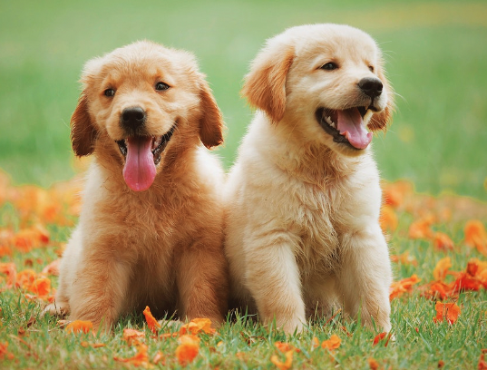

Abstract
With dogs becoming more and more popular as companions, there is an increasing need to address worries about their safety and well-being, especially when they are left unattended. The ESP8266 microcontroller, MLX90614 infrared sensor, sound sensor module, and heartbeat sensor are used in this paper's IoT-based pet monitoring system to monitor the environment of pets, identify signs of distress, and assure their general health and safety. By utilising the potential of IoT technology and different sensors, this system aims to give pet owners a complete solution for remotely monitoring and caring for their animals.

Slide 4
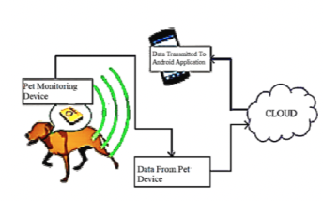
Background
Pets play a significant role in people's lives as companions, providing emotional support and companionship. However, concerns arise when pets are left alone, as their safety and well-being become a primary concern for pet owners. The advancements in IoT technology have opened up opportunities to address these concerns by developing innovative pet monitoring systems that utilize sensors and connectivity to ensure pets' health and safety remotely. By leveraging the capabilities of ESP8266, MLX90614, sound sensor module, and heartbeat sensor, this research aims to contribute to the growing field of IoT-based pet monitoring systems and provide pet owners with a reliable and efficient solution to care for their pets even when they are away.

Slide 5
Literature Review 1
Title of paper and Author | Journal/ Conference and year | Concept/ Approach | Limitations | Inference
Intelligent pet monitor system with the internet of things. Chung-Ming Own; Cheng-Ya Teng; Jing-Ran Zhang; Wen-Yuan Yuan; Shang-Chun Tsai | Date of Conference: 10-13 July 2011 DOI: 10.1109/ICMLC.2011.6016785 Conference Location: Guilin, China | Light sensor to detect pet Humidity and temperature monitoring sensors Pet food dispenser | Static prototype to monitor pet conditions using manually. No automation | No automation, no health monitoring automatically and usage of NOBLE cloud integration algorithms to monitor and alert behavioural pattern.

Slide 6
Literature Review 2
Title of paper and Author | Journal/ Conference and year | Concept/ Approach | Limitations | Inference
Development of IoT Based Smart Animal Health Monitoring System Using Raspberry Pi Seema Kumari Sumit Kumar Yadav | Research: Volume 3 Issue 8, 2018 | Monitor heart rate, body temperature, and rumination. Transfer data to cloud and display in monitor. | No provision of ML algorithms to detect behavioural and emotional pattern. Little automation. | Little automation, no NOBLE ML algorithms to detect behavioural patterns and provide a complete solution to pet parents.

Slide 7
Literature Review 3
Title of paper and Author | Journal/ Conference and year | Concept/ Approach | Limitations | Inference
Internet of Things: Real-Time Pet Monitoring System Gowri Rao Kotekar1, Pranith S Kanchan2, Sharath Kumar3, U Nishchinta | DOI: 3rd and 4th May, 2019 | Detection of pet’s location using GPS and pet food dispensing using IOT. | Static prototype to and no monitoring of health points. No automation | Little automation, no NOBLE ML algorithms to detect behavioural patterns and provide a complete solution to pet parents.

Slide 8
Literature Review 4
Title of paper and Author | Journal/ Conference and year | Concept/ Approach | Limitations | Inference
Machine Learning Models for Determining Pet Health Condition ASCC 2022 | Conference: 2022 The 13th Asian Control Conference (ASCC 2022) At: Jeju Island, Korea | Parameters such as body weight growth, body temperature, heart rate, eating habits, activity levels, sleep patterns, and urine pH are examined using different machine learning models, quadratic & linear support vector machine, fine tree, and logistic regression. | Not a scalable product. Only use purpose is for research and not for pet parent’s use. | Existence of a ML algorithm to detect health points. Additional need to create a ML model to detect emotional and behavioural pattern

Slide 9
Literature Review 5
Title of paper and Author | Journal/ Conference and year | Concept/ Approach | Limitations | Inference
Integration of animal tracking and health monitoring systems | DOI 10.1088/1757-899X/1098/4/042075 | An animal temperature monitoring and location tracking system based on GPS and SMS technology was developed using Arduino Pro Mini microcontroller and GSM module. The system achieved a high accuracy of 99.62% in temperature measurement compared to conventional thermometers and 98.7% accuracy in location tracking compared to Google Maps. | Only temperature and location tracking and no health points. Redundant | Little automation, no NOBLE ML algorithms to detect behavioural patterns and provide a complete solution to pet parents.

Slide 10
PROBLEM DESCRIPTION
Pet parents face a challenge in monitoring the health of their dogs due to their busy schedules and limited resources. The current lack of a fully automatic health monitoring system for dogs leaves a gap in effectively tracking and managing their well-being. Existing solutions rely on manual observation and intervention, leading to subjectivity and potential delays in detecting health issues.
To address this problem, there is a need for a comprehensive system that continuously monitors vital health parameters such as heart rate, body temperature, barking patterns, and environmental temperature. This system should integrate advanced machine learning algorithms to accurately analyze and classify a dog's emotional and physical health based on the collected data. Additionally, the system should include automated data processing and analysis in the cloud, enabling real-time monitoring and timely alerts to pet parents for any abnormal behavior or potential health concerns. By developing such a system, pet parents can ensure the well-being of their dogs and have peace of mind knowing that their pets' health is being monitored effectively.

Slide 11
Research Gap and Proposed Solution
The problem lies within the fact that pet parents have a lot of jobs to focus on and need a fully automatic health monitoring system to keep them relaxed. The need of the hour is:
A proper dataset to propose to the scientific community to collect and analyse data of day to day behaviour of dogs.
Proper data points as in Heart Rate, Body Temperature, Barking patterns and Environment temperature that are basic data points to analyse a dog’s physical and emotional health.
Recognising a proper ML algorithm to classify emotional and physical health and creation of one if needed.
Processing of data and transferring it to cloud where ML algorithm analyses and detects behavioural pattern and monitors complete health status automatically.
Alerting outlying behaviour via Blynk App to check if condition is normal manually via the usage of ESP32 Cam module connected to food dispenser.

Slide 12
Research Gap and Proposed Solution
The research gap lies in the lack of a fully automatic health monitoring system for dogs that integrates multiple data points and machine learning algorithms to provide comprehensive and real-time analysis of their physical and emotional health. Existing systems may focus on a limited set of parameters or rely on manual inputs, which can be time-consuming and prone to human error. Additionally, there may be a lack of standardized datasets and robust algorithms specifically designed for classifying the health status of dogs based on their behavior.

Slide 13
Research Gap and Proposed Solution
Comprehensive Dataset: A properly designed dataset will be proposed to collect data on various aspects of a dog's behavior, including heart rate, body temperature, barking patterns, and environmental temperature. The dataset will be diverse and representative of different breeds and sizes of dogs, ensuring its applicability across a wide range of scenarios.
Machine Learning Algorithm: A suitable machine learning algorithm, such as Support Vector Machines (SVM), Random Forest, or Neural Networks, will be identified or developed to classify the emotional and physical health of dogs based on the collected data. The algorithm will undergo rigorous training and validation using the proposed dataset to ensure accurate and reliable classification.

Slide 14
Research Gap and Proposed Solution
Cloud-based Analysis: The data collected from the dogs will be processed and transferred to a cloud-based system for efficient analysis. Cloud infrastructure, such as Google Cloud AI or Microsoft Azure, will be utilized to handle the large volume of data and deploy the trained machine learning algorithm for real-time analysis of the behavioral patterns and health status of dogs.
Alerting System: If any outlying behavior or potential health issues are detected, an alert will be generated and sent to the pet parents via a Blynk App. The alert will prompt the pet parents to manually check the dog's condition and take appropriate action if necessary. Additionally, an ESP32 Cam module connected to a food dispenser can automate the provision of food based on the analysis of the dog's health status.

Slide 15
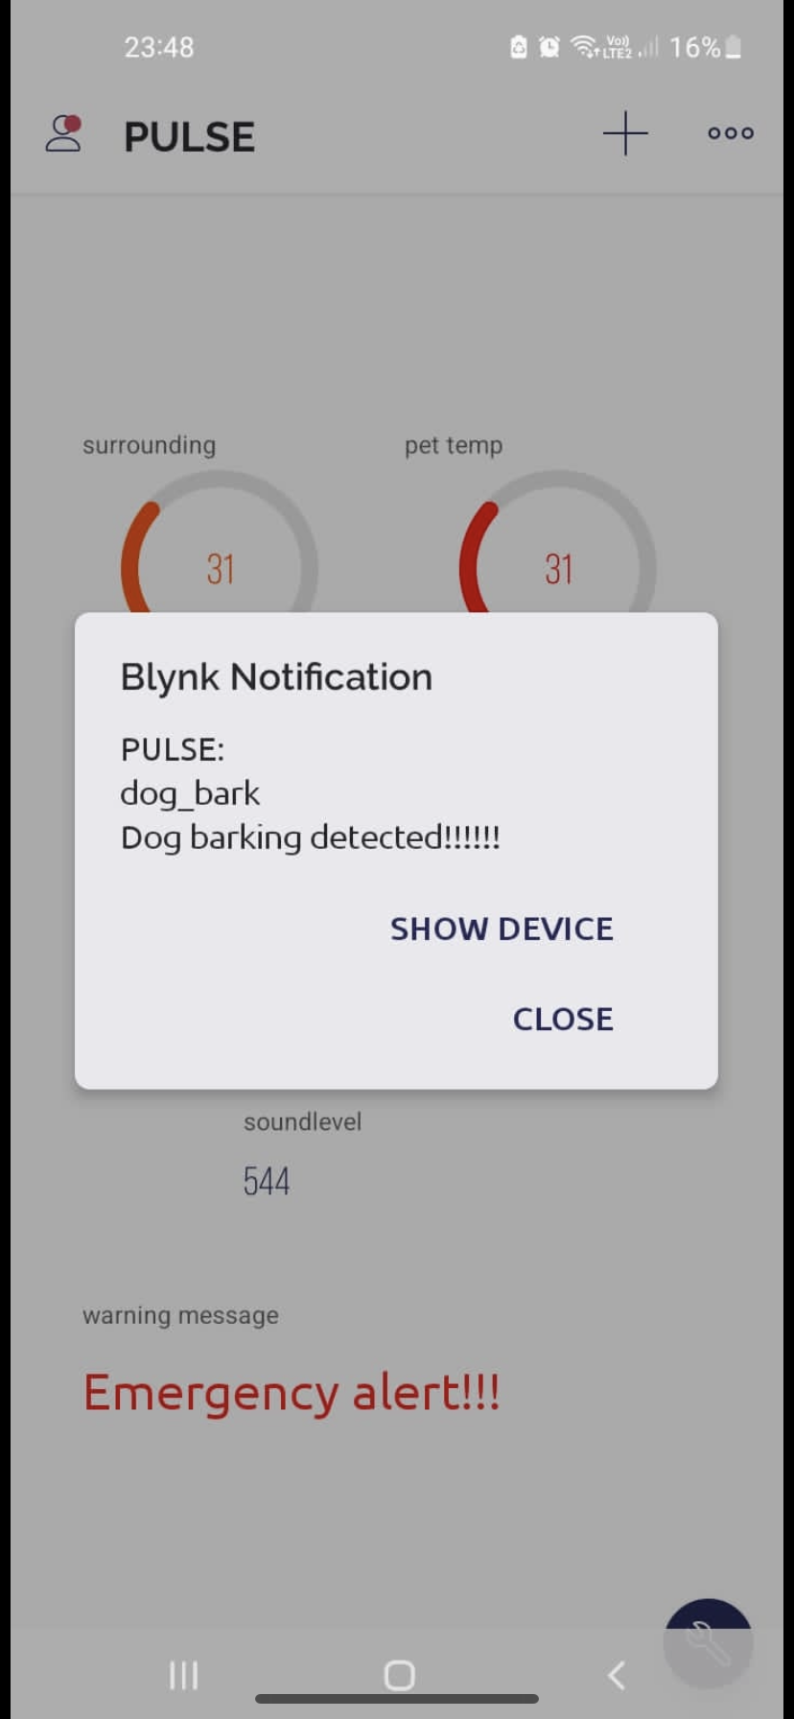
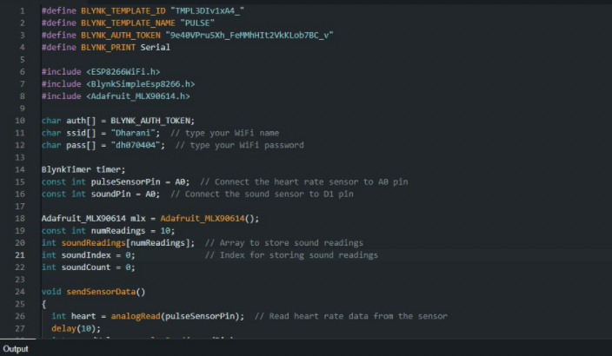
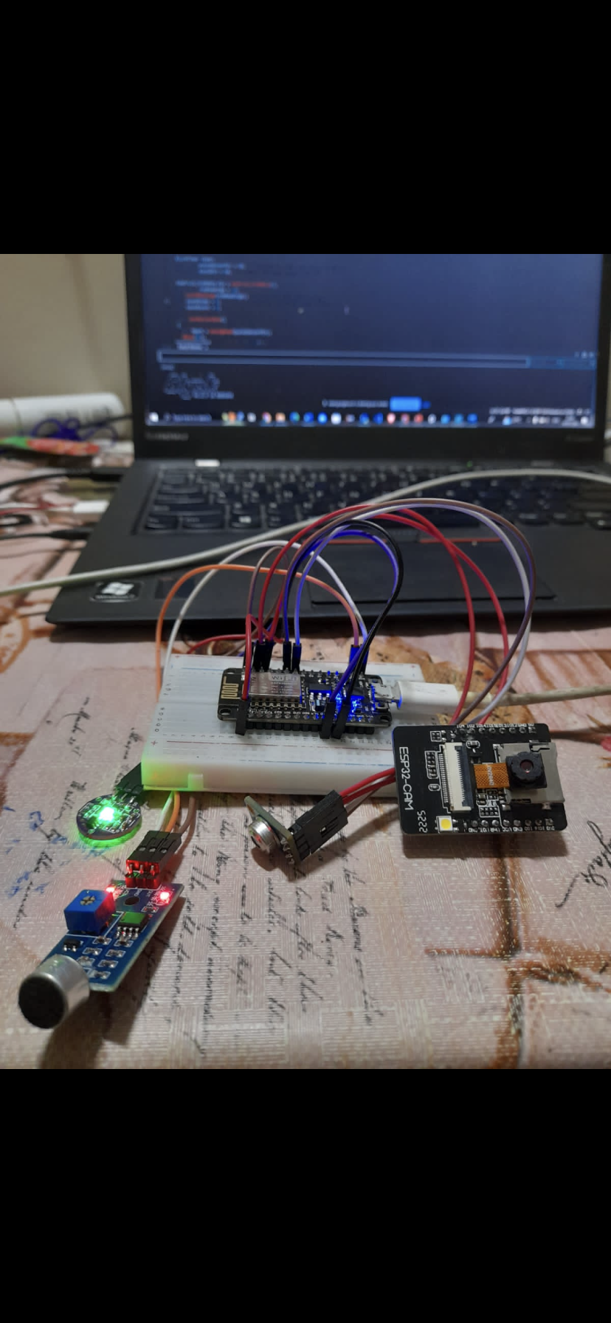
Tools used
ESP8266 Module
Sound Sensor
Non Contact Temperature Sensor MLX90614 module
Heart rate Sensor
Blynk Cloud App
Arduino IDE

Slide 16
RESULTS AND DISCUSSIONS
Dataset Proposal: To collect and analyze data on the day-to-day behavior of dogs, a comprehensive dataset can be designed and proposed to the scientific community. The dataset should include various data points that provide insights into a dog's physical and emotional health. These data points can include:
Heart Rate: Monitor the dog's heart rate using a wearable device such as a heart rate monitor collar. Record heart rate measurements at regular intervals throughout the day.
Body Temperature: Measure the dog's body temperature using a non-invasive thermometer. Take temperature readings multiple times a day and record them in the dataset.
Barking Patterns: Utilize audio sensors to capture and analyze the dog's barking patterns. Differentiate between various types of barks such as alert barks, playful barks, or distressed barks.
Environment Temperature: Deploy temperature sensors in the dog's living area to monitor the ambient temperature. This data point can help assess the dog's comfort and ensure a suitable environment.

Slide 17
RESULTS AND DISCUSSIONS
Additionally, other relevant information can be included, such as feeding schedules, exercise routines, and any medication administered. This dataset should be collected from a diverse range of dogs to ensure its applicability to various breeds and sizes.
ML Algorithm for Classification: Various machine learning algorithms can be explored to classify a dog's emotional and physical health based on the collected data. Some potential algorithms that can be considered include:
Support Vector Machines (SVM): SVMs can be trained using the dataset to classify dogs into different health categories based on the provided data points.
Random Forest: This ensemble learning algorithm can be used to classify the health status of dogs by building multiple decision trees and combining their outputs.
Neural Networks: Deep learning models such as convolutional neural networks (CNNs) or recurrent neural networks (RNNs) can be employed to classify dogs' health based on sequential data or image-based inputs.

Slide 18
RESULTS AND DISCUSSIONS
The choice of algorithm depends on the nature of the data, available computing resources, and the desired performance. It may be necessary to experiment with different algorithms and compare their results to determine the most suitable approach.
Data Processing and Cloud Analysis: Once the data is collected, it needs to be processed and transferred to a cloud-based system for analysis. Preprocessing steps may include data cleaning, normalization, and feature extraction. The processed data can then be sent to the cloud infrastructure where the ML algorithm is deployed.
Cloud-based ML platforms such as Google Cloud AI, Microsoft Azure, or Amazon AWS can be utilized for scalability and efficient analysis. These platforms provide services like data storage, distributed computing, and ML model deployment, making it easier to process and analyze large volumes of data.

Slide 19
RESULTS AND DISCUSSIONS
Monitoring and Alerting: The ML algorithm deployed on the cloud can continuously analyze the behavioral patterns and health status of the dogs. If any outlying behavior or potential health issues are detected, an alert can be generated to notify the pet parents.
One possible method of alerting is by using the Blynk App, which can be integrated with the cloud system. The app can send real-time notifications to the pet parents' smartphones, alerting them to check the condition of their dog manually.
Additionally, an ESP32 Cam module connected to a food dispenser can be utilized to automate the process of providing food to the dog based on the analysis of the health status.

Slide 20
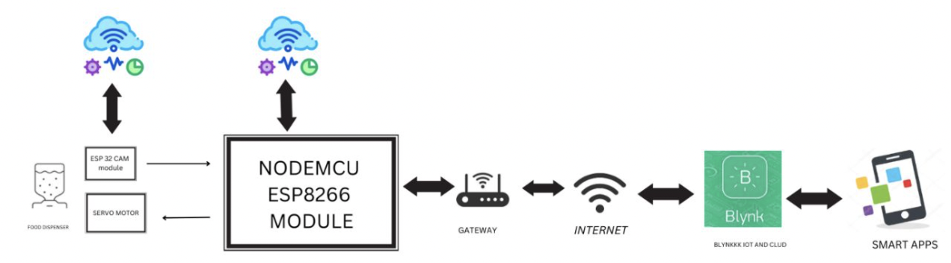
BLOCK DIAGRAM OF PROPOSED SOLUTION

Slide 21
REFERENCES
CHUNG-MING OWN! CHENG-YA IENG2 JING-RAN ZHANG3 WEN-YUAN YUAN' SHANG-CHUN ISAIs Department of Computer and Communication Engineering, st. John's University, Taiwan 62107, R.0.c.
Development of IoT Based Smart Animal Health Monitoring System using Raspberry Pi Seema Kumaria , Dr. Sumit Kumar Yadavb aStudent, Department of Electronics, IGDTUW, Delhi-110006, India bAssistant Professor, Department of Computer Science, IGDTUW, Delhi-110006, India
Internet of Things: Real-Time Pet Monitoring System Gowri Rao Kotekar1, Pranith S Kanchan2, Sharath Kumar3, U Nishchinta4
Machine Learning Models for Determining Pet Health Condition ASCC 2022, Ravi Ghimire, Pusan National University.
Integration of animal tracking and health monitoring systems K Saputra, L Kamelia* and E A Zaki Electrical Engineering Department, Faculty of Science and Technology, UIN Sunan Gunung Djati Bandung, Jl. A.H Nasution 105, Bandung, Indonesia

